Slide 1
Online Retail Store Analysis
By Chaitra VL
Date: 5-2-2025

Slide 2
AGENDA
Introduction of Online Retail Company
Objective of Analysis
Overview / Analytical Tools used
Sales Performance Analysis
Monthly Revenue Analysis
Revenue Analysis
Payment Method Distribution Analysis
Customer Insights & Purchase Behavior
Gender Distribution and Contribution to Sales
Age Distribution Analysis
Customer Feedback & Sentiment Analysis
Sentiment Analysis
Product Rating Comparision Analysis
Website Traffic & User Behavior
Traffic Source Comparision Analysis
Correlation Comparision Analysis
Power BI Dashboard

Slide 3
Introduction to Online Retail Company
An online retail company is a business that sells products or services directly to consumers through the internet. This business model eliminates the need for physical stores, allowing customers to shop from the comfort of their own homes or on-the-go via mobile devices. Online retailers typically operate through a website or mobile app, offering a wide variety of products ranging from clothing, electronics, groceries, to books, and more.
The main benefits of an online retail business include:
Global Reach: Online retailers can reach customers worldwide, expanding their market far beyond local or regional boundaries.
Convenience: Customers can shop anytime, anywhere, making it a convenient option compared to traditional brick-and-mortar stores.
Lower Overhead Costs: Without the need for physical storefronts, online retailers can reduce expenses related to rent, utilities, and in-store staff.
Personalized Shopping Experience: Many online retailers leverage data analytics and artificial intelligence to offer personalized recommendations, promotions, and tailored experiences to shoppers.
Variety and Accessibility: Online platforms can offer a wider range of products without the constraints of physical shelf space.

Slide 4
Objective of Analysis
The objective of this online retail store project is to analyze and gain valuable insights from a dataset related to customer behavior, product sales, and business performance using Python for Exploratory Data Analysis (EDA). The project aims to understand key patterns and trends, optimize business strategies, and improve customer experience by leveraging data analytics.
The final deliverable of the project will include an interactive Power BI dashboard that provides a comprehensive overview of the business.
The dashboard will include visualizations of customer segments, product sales, revenue trends, and other key performance indicators (KPIs), enabling stakeholders to explore the data in real time and make data-driven decisions
Through this project, the goal is to provide actionable insights that can drive business strategies, improve customer engagement, and enhance operational efficiency. The use of Python for EDA will help uncover patterns in the data, and the Power BI dashboard will ensure that these insights are accessible and understandable to the team.

Slide 5
Overview
The goal of this project is to analyze sales transaction data, customer feedback, demographic insights, and website traffic to identify customer purchase patterns and business trends. The insights derived will help optimize marketing strategies, inventory management, and customer experience.
Key Insights & Business Impact:
Identified peak sales periods and optimized inventory restocking strategies.
Recognized high-value customer segments and developed personalized marketing campaigns.
Addressed negative feedback patterns to enhance customer satisfaction and loyalty.
Analytical Tools Used
Python (Data Manipulation, Statistical Analysis): Pandas, NumPy, Matplotlib, Seaborn, ANOVA Test(to see statistically significant difference in the average monthly revenue among different products).
Power BI(Data Visualization, Interactive Dashboard): Real-time Insights, Interactive Charts, Key metrics & KPI's.

Slide 6
Sales Performance Analysis
Sales performance analysis is crucial in an online retail store project because it helps businesses understand trends, optimize strategies, and drive growth.
Identifying Best-Selling Products & Categories
Understanding Customer Behavior
Revenue & Profitability Insights
Monthly Revenue Analysis
Payment Method Distribution Analysis
By analyzing sales performance, an online retail store can increase profitability, improve customer satisfaction, and maintain a competitive edge in the market.

Slide 7
Monthly Revenue Analysis
This monthly revenue trend graph provides insights into sales performance over time, highlighting seasonal patterns, peak sales periods.
Business Implication :
Promotion: Plan marketing campaigns during slow periods.
Stock Optimization: Align inventory with peak demand months to prevent stockouts.
Budget Allocation: Adjust operational and marketing budgets based on revenue trends.

Slide 8
Revenue Analysis
Analyzing revenue by product category helps in understanding which product lines contribute the most to overall sales.
Business Implication :
Strategic Inventory Management: Stock more of the best-selling categories to avoid shortages.
Targeted Marketing Campaigns: Promote low-selling categories through discounts or ads.
Pricing Strategy: Adjust pricing based on category performance to maximize profit.

Slide 9
Payment Method Distribution Analysis
Analyzing which payment methods are most commonly used helps businesses cater to customer preferences, optimize checkouts experience, and identify opportunities to enhance payment options.
Business Implication :
Reducing Cart Abandonment: Optimize the checkout process by ensuring the most-used payment methods are seamless and accessible.
Security & fraud Prevention: Strengthen fraud detection measures for payment methods.
Regional Payment Preferences: Adjust payment options based on customer location trends.

Slide 10
Customer Insights & Purchase Behavior
Understanding customer insights and purchase behavior is crucial for any online retail store because it helps businesses tailor their strategies to increase sales, improve customer experience, and enhance retention.
Personalized Customer Experience
Customer Retention & Loyalty
Gender Distribution and Contribution to Sales
Age Distribution Analysis
Optimizing Pricing & Promotions
By leveraging customer insights and purchase behavior, an online retailer can create a more personalized, efficient, and profitable business model. This leads to higher conversion rates, stronger customer relationships, and long-term success.

Slide 11
Gender Distribution & Contribution to sales
Analyzing gender distribution in sales helps businesses understand customer buying behavior and market trends, identifying which gender contributes the most to revenue, businesses can tailor marketing strategies, product offering and customer engagement efforts.
Business Implication :
Personalized Marketing Strategies : Create targeted campaigns based on gender-based purchasing trends.
Customer Engagement & Loyalty Programs : Design loyalty rewards based on gender-specific shopping behavior.
Expanding Market Reach: Identify opportunities to increase engagement from the lower-contributing gender segment.

Slide 12
Age Distribution Analysis
By analyzing which age groups contribute the most to sales, businesses can make data-driven decisions to improve customer engagement and maximize revenue.
Business Implication :
Tailored Marketing Strategies: Design campaigns that appeal to the most active age groups.
Product Recommendations: Offer age-specific product suggestions based on purchasing patterns.
Loyalty & Engagement Programs: Develop targeted promotions and discounts for different age segments.

Slide 13
Customer Feedback & Sentiment Analysis
Customer feedback and sentiment analysis play a crucial role in the success of an online retail store by helping businesses understand customer satisfaction, preferences, and pain points.
Understanding Customer Satisfaction
Identifying Product & Service Issues
Sentiment Analysis
Product Rating Comparision Analysis
Enhancing Brand Reputation
Competitive Advantage
By leveraging customer feedback and sentiment analysis, online retailers can create a more customer-focused, reputation-driven, and competitive business. Addressing issues, improving products, and enhancing customer interactions lead to higher customer satisfaction, better sales, and long-term success.

Slide 14
Sentiment Analysis
Sentiment analysis helps businesses understand how customers feel about their products, services, and overall shopping experience.
Business Implication :
Enhancing Customer Experience: Address negative feedback proactively to improve service quality.
Reputation Management: Respond to negative feedback effectively to build trust and credibility.
Marketing & Brand Messaging: Highlight positive sentiments in marketing campaigns to boost customer confidence.

Slide 15
Product Rating Comparision Analysis
Product ratings provide valuable insights into customer satisfaction and product performance. By comparing product ratings, businesses can identify top-performing products, detect areas for improvement, and optimize their inventory and marketing strategies based on customer preferences.
Business Implication :
Product Improvement Strategy: Address recurring issues in low-rated products.
Marketing & Promotions: Promote high-rated products to boost sales and credibility.
Customer Engagement: Encourage customers to leave reviews and provide feedback.

Slide 16
Website Traffic & User Behavior ​
Understanding website traffic and user behavior is crucial for an online retail store because it helps optimize the customer journey, improve conversions, and maximize revenue.
Measuring Website Performance
Understanding Customer Journey
Traffic Source Comparision Analysis
Correlation Comparision Analysis
Identifying Popular Products & Pages
Enhancing Marketing & SEO Strategies
Tracking website traffic and user behavior helps online retailers make data-driven decisions to enhance user experience, optimize marketing efforts, and increase sales. Understanding how users interact with the site ensures businesses can continuously improve and stay ahead in a competitive market.

Slide 17
Traffic Sources Comparision Analysis
Understanding where website traffic comes from helps businesses optimize marketing strategies, allocate budgets effectively, and improve customer acquisition efforts. By comparing traffic sources, businesses can determine which channels drive the most visitors and conversions.
Business Implication :
SEO & Content Strategy: Strengthen organic search traffic by improving SEO and content marketing.
Ad Spend Efficiency: Adjust paid advertising based on traffic and conversion insights.
Social Media & Email Strategy: Enhance engagement tactics for channels with lower traffic contributions.

Slide 18
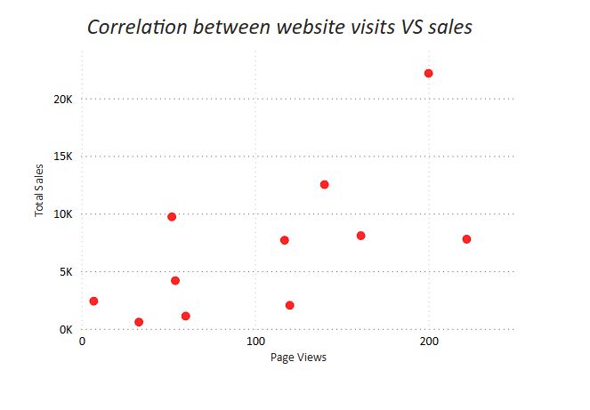
Correlation Comparision Analysis
Understanding the relationship between website visits and sales is crucial for assessing the effectiveness of your online presence. By analyzing this correlation, businesses can determine how traffic impacts revenue.
Business Implication :
Optimizing Traffic conversion: Focus on improving the conversion rate of website visitors to paying customer.
Targeted Marketing Campaigns: Boost traffic through SEO, ads, and social media.
Sales Forecasting: Use website visit data to predict sales trends and make better inventory and marketing decisions.

Slide 19
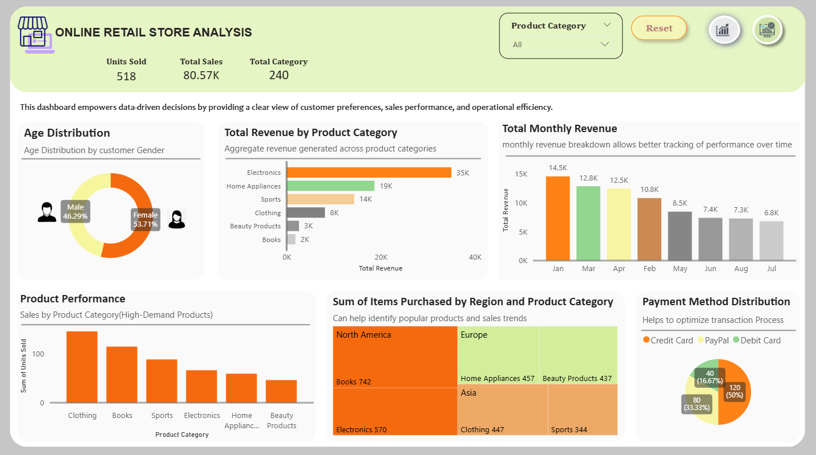
Dashboard Preview

Slide 20
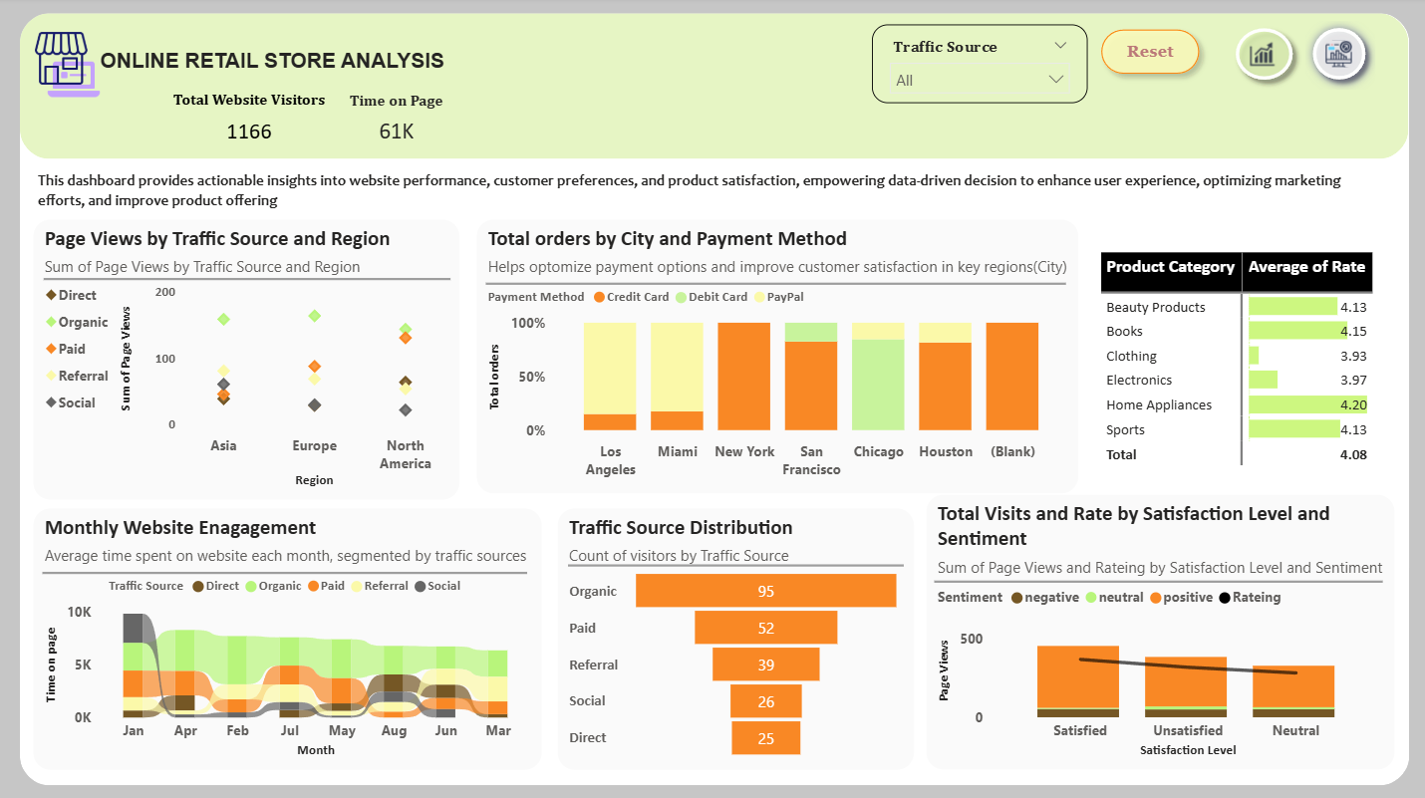
Dashboard Preview

Slide 21






GitHub Link: GitHub - Chaitra-VL-11/Online_Retail_Store_Analysis Portfolio Link: https://www.datascienceportfol.io/chaithravlc LinkedIn Link: https://www.linkedin.com/in/chaitra-vl Email Address: chaithravlc@gmail.com
Chaitra VL
Data Analyst at Apana Time
Thank You

